Slide 1
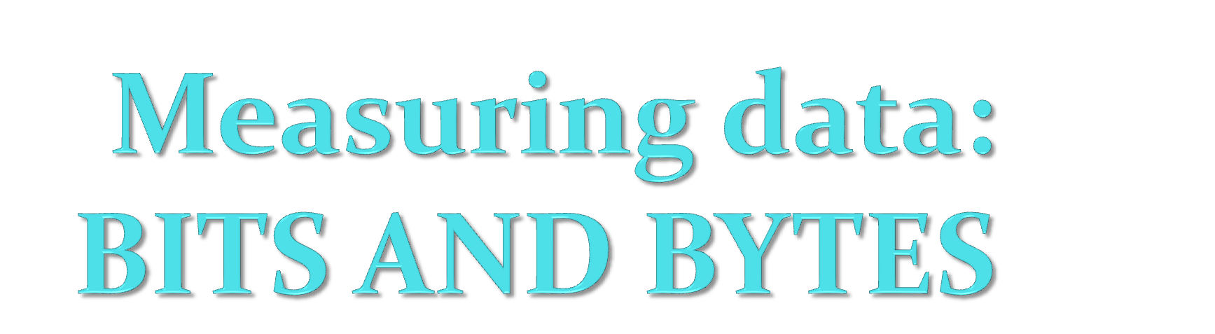

Slide 2
Bit
We measure computer information (data) in bits and bytes. ‘Bit’ is short form for ‘binary digit’ . It is the smallest unit of information that a computer can understand. One bit represents a 1 or 0 digit in binary numeral, or a true or false logical condition. A bit represented by a high or low voltage in a circuit or a small magnetized spot on a disk. A human probably wouldn’t find the information in one bit of data very useful.

Slide 3
Byte
‘Byte’ is short for ‘binary term’. A byte usually contains eight bits. It can represent a single character, such as a letter, a digit, or a punctuation mark. Because of a byte represents only small amount of information, we usually measure amounts of computer memory and storage in kilobytes (one kilobyte is 1024 bytes), megabytes (one megabyte is 1048576) or gigabytes (one gigabyte is 1073748124).

Slide 4
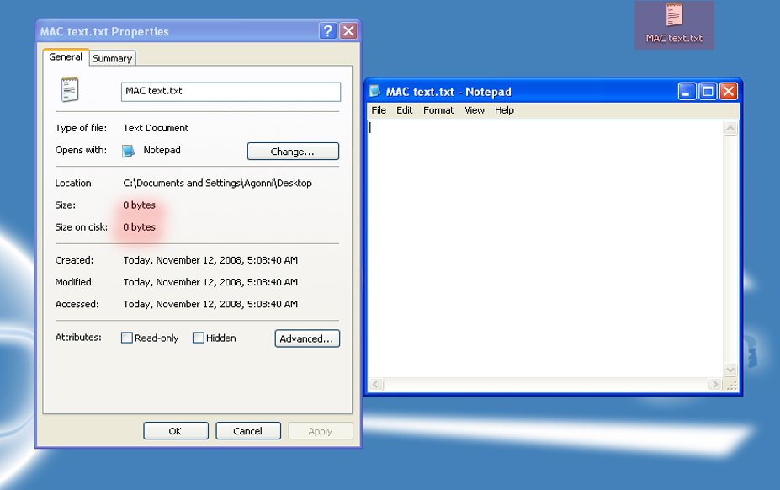
EX-1) No characters writen.

Slide 5
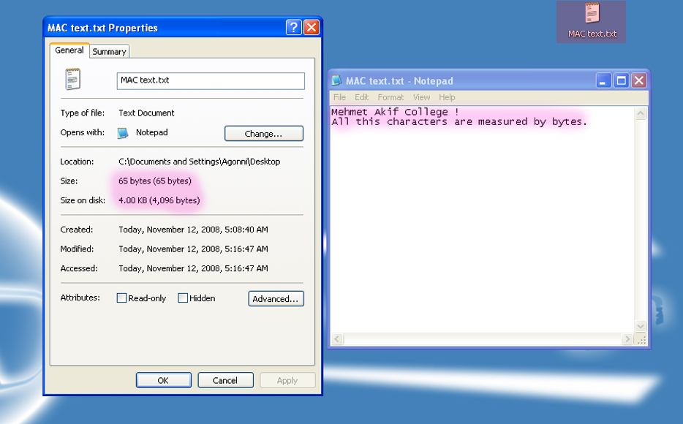
EX-2) Some characters writen

Slide 6
Bits and Bytes value calculator.

